Slide 1
Web Media
Chapter 6

Slide 2
Chapter 6
1
Digital Representations of Images
2
Color Models
3
Image Concepts
4
File Formats
5
Audio and Video
6
Summary

Slide 3
Chapter 6
1
Digital Representations of Images
2
Color Models
3
Image Concepts
4
File Formats
5
Audio and Video
6
Summary

Slide 4
Digital Representation of Images
Digital compared to Print

Slide 5
Digital Representation of Images
Raster

Slide 6
Digital Representation of Images
Vector

Slide 7
Digital Representation of Images
Resizing – an example

Slide 8
Chapter 6
1
Digital Representations of Images
2
Color Models
3
Image Concepts
4
File Formats
5
Audio and Video
6
Summary

Slide 9
Color Models
More than 1 model

Slide 10
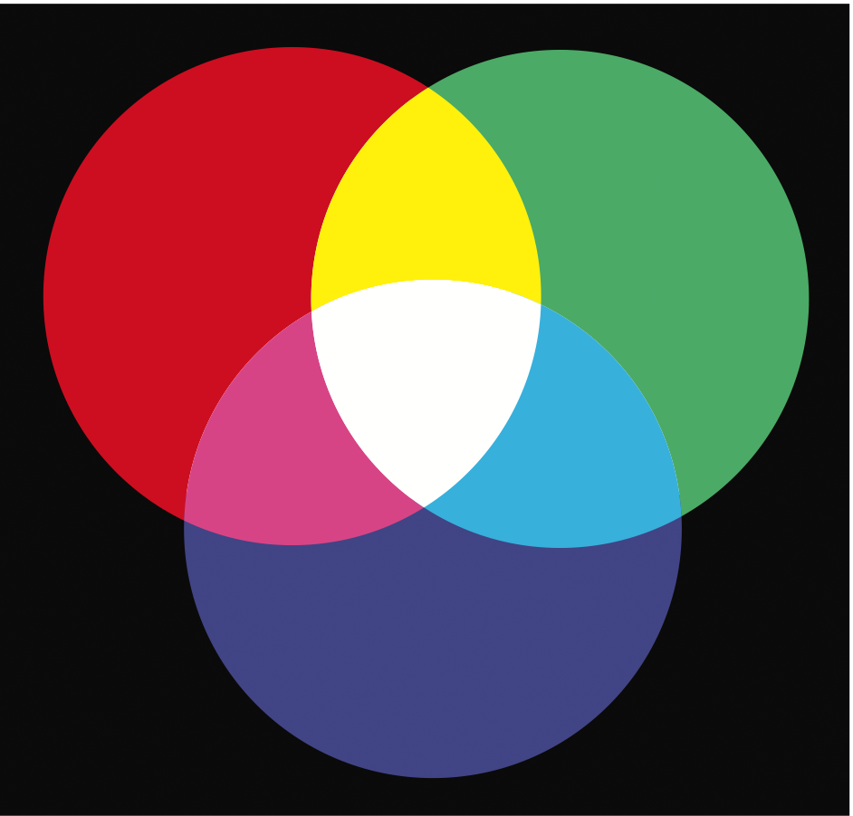
Color Models
RGB

Slide 11

Color Models
CMYK

Slide 12
Color Models
HSL

Slide 13
Color Models
Opacity

Slide 14
Color Models
Opacity

Slide 15
Color Models
Gradients

Slide 16
Color Models
Color Relationships - Wheel

Slide 17
Color Models
Color Relationships

Slide 18
Color Models
Color Relationships

Slide 19
Color Models
Color Relationships

Slide 20
Chapter 6
1
Digital Representations of Images
2
Color Models
3
Image Concepts
4
File Formats
5
Audio and Video
6
Summary

Slide 21
Image Concepts
Color Depth
Color depth refers to the maximum number of possible colors that an image can contain.

Slide 22
Image Concepts
Dithering

Slide 23
Image Concepts
Image Size
Raster images contain a fixed number of pixels; as such, image size refers to how many pixels it contains.
The size of an image onscreen is determined by the pixel dimensions of the image, the monitor size, and the computer’s display resolution
Whenever you resize (either larger or smaller) a raster image, the program doing the resizing must interpolate

Slide 24
Image Concepts
Image Size - Interpolate

Slide 25
Image Concepts
Image Size - Interpolate

Slide 26
Image Concepts
Image Size - Enlarging versus reduction

Slide 27
Image Concepts
Image Size – Enlarging in browser vs enlarging originals

Slide 28
Image Concepts
Display Resolution

Slide 29
Chapter 6
1
Digital Representations of Images
2
Color Models
3
Image Concepts
4
File Formats
5
Audio and Video
6
Summary

Slide 30
File Formats
JPEG
JPEG (Joint Photographic Experts Group) or JPG is a 24-bit, true-color file format that is ideal for photographic images
lossy compression
can create artifacts

Slide 31
File Formats
JPEG

Slide 32
File Formats
JPEG

Slide 33
File Formats
GIF
The GIF (Graphic Interchange Format) file was the first image format supported by the earliest web browsers.
pronunciation controversy
GIF is an 8-bit or less format, meaning that it can contain no more than 256 colors.
Not great for photos

Slide 34
File Formats
GIF

Slide 35
File Formats
GIF (Run length compression)

Slide 36
File Formats
GIF (Pallete)

Slide 37
File Formats
GIF (Transparency)

Slide 38
File Formats
GIF (Transparency)

Slide 39
File Formats
PNG
Portable Network Graphics
Lossless compression.
8-bit (or 1-bit, 2-bit, and 4-bit) indexed color as well as full 24-bit true color (higher color depths are supported as well).
From 1 to 8 bits of transparency.

Slide 40
File Formats
PNG

Slide 41
File Formats
SVG
Scalable Vector Graphics

Slide 42
File Formats
Other Formats
The TIF (Tagged Image File) format is a cross-platform lossless image format that supports
multiple color depths, 8-bit transparency, layers and color channels, the CMYK and RGB color space, and other features especially useful to print professionals.
WebP is a new image file format promoted by Google. It supports both lossy and lossless compression, and Google claims WebP compression results are superior in comparison to JPG or PNG formats.

Slide 43
Chapter 6
1
Digital Representations of Images
2
Color Models
3
Image Concepts
4
File Formats
5
Audio and Video
6
Summary

Slide 44
Audio and Video
Media Concepts - Containers
Media is encoded using compression/decompression software, usually referred to as a codec (for compression/decompression).
The second key concept for understanding media formats is that of container formats .

Slide 45
Audio and Video
Media Concepts - Containers

Slide 46
Audio and Video
Browser Video Support
MPEG-4
MP4 container with H.264 Video and AAC Audio
WebM container with VP8 video and Vorbis audio.
Ogg container with Theora video and Vorbis audio

Slide 47
Audio and Video
Using the <video> element

Slide 48
Audio and Video
Browser Audio Support
MP3.
WAV.
OGG
Web
MP4

Slide 49
Audio and Video
Using the <audio> element

Slide 50
Chapter 6
1
Digital Representations of Images
2
Color Models
3
Image Concepts
4
File Formats
5
Audio and Video
6
Summary

Slide 51
Summary
Key Terms
additive colors
alpha transparency
anti-aliasing
artifacts
bitmap image
cinemagraph
CMYK color model
codec
color depth
color palette
container formats
device pixels
digital representation
display resolution
dithering
favicon
gamut
GIF
gradient
halftones
HSL color model
image size
interpolate
JPEG
lightness
lossless compression
lossy compression
LZW compression
media encoding
MPEG-4
opacity
pixels
PNG
raster image
reference pixel
RGB color model
run-length compression
saturation
subtractive colors
SVG
TIF
transform
transition
vector image
web-safe color palette

Slide 52
Questions

